Slide 1
Stacking Wood for Maximum Heat, Longest Burning time, and Ambiance
This Power Point presentation will guide you through instruction for:
Stacking wood for a fire in a fireplace that will produce maximum heat to warm your room.
Stacking wood for a fire in a fireplace that will burn for the longest period of time.
Stacking wood for a desired ambiance.
NEXT

Slide 2
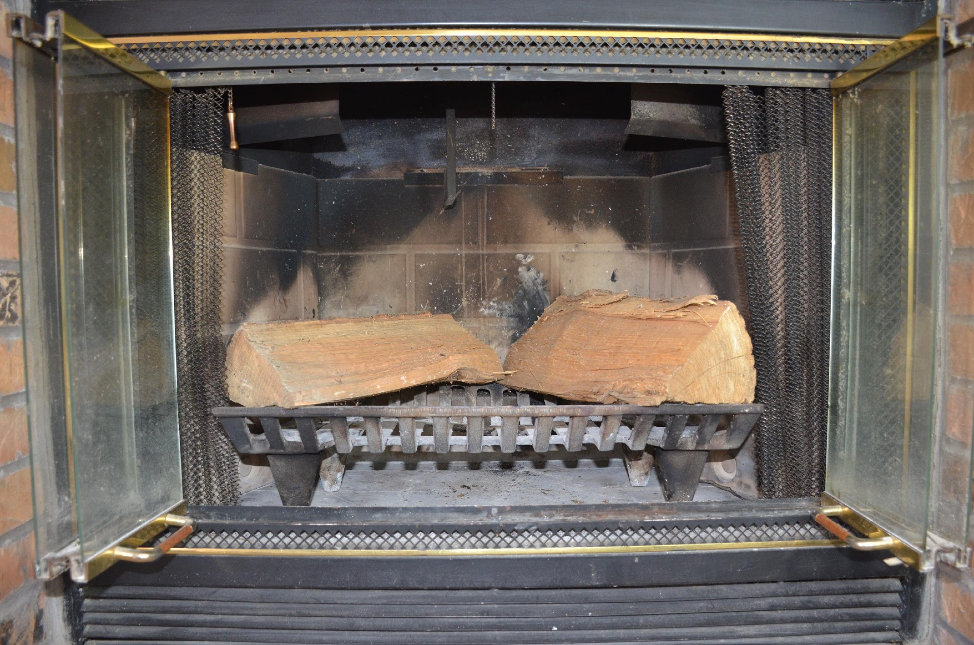
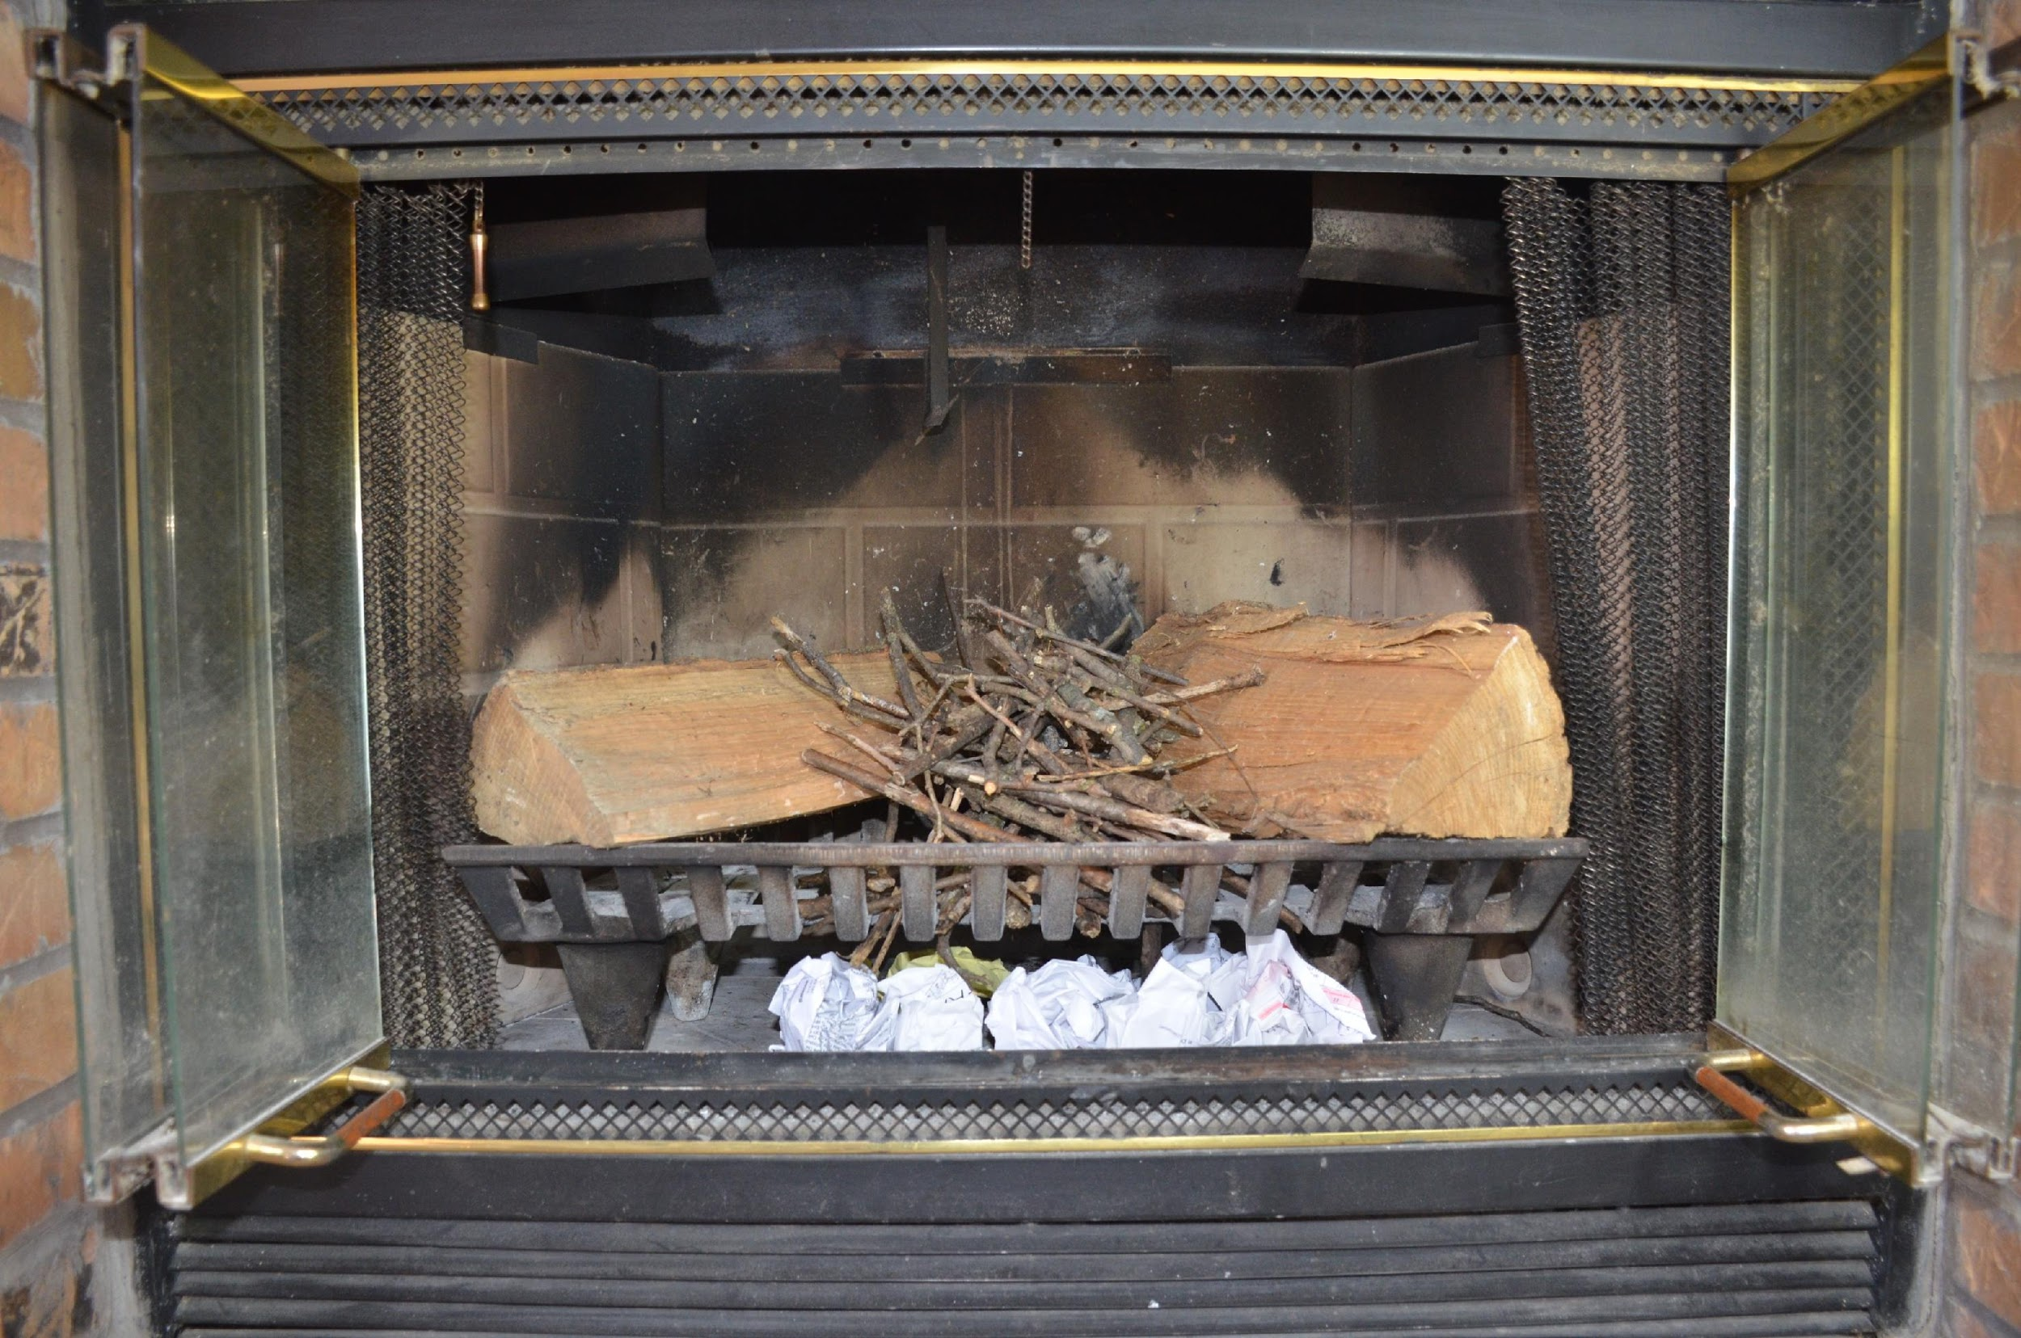
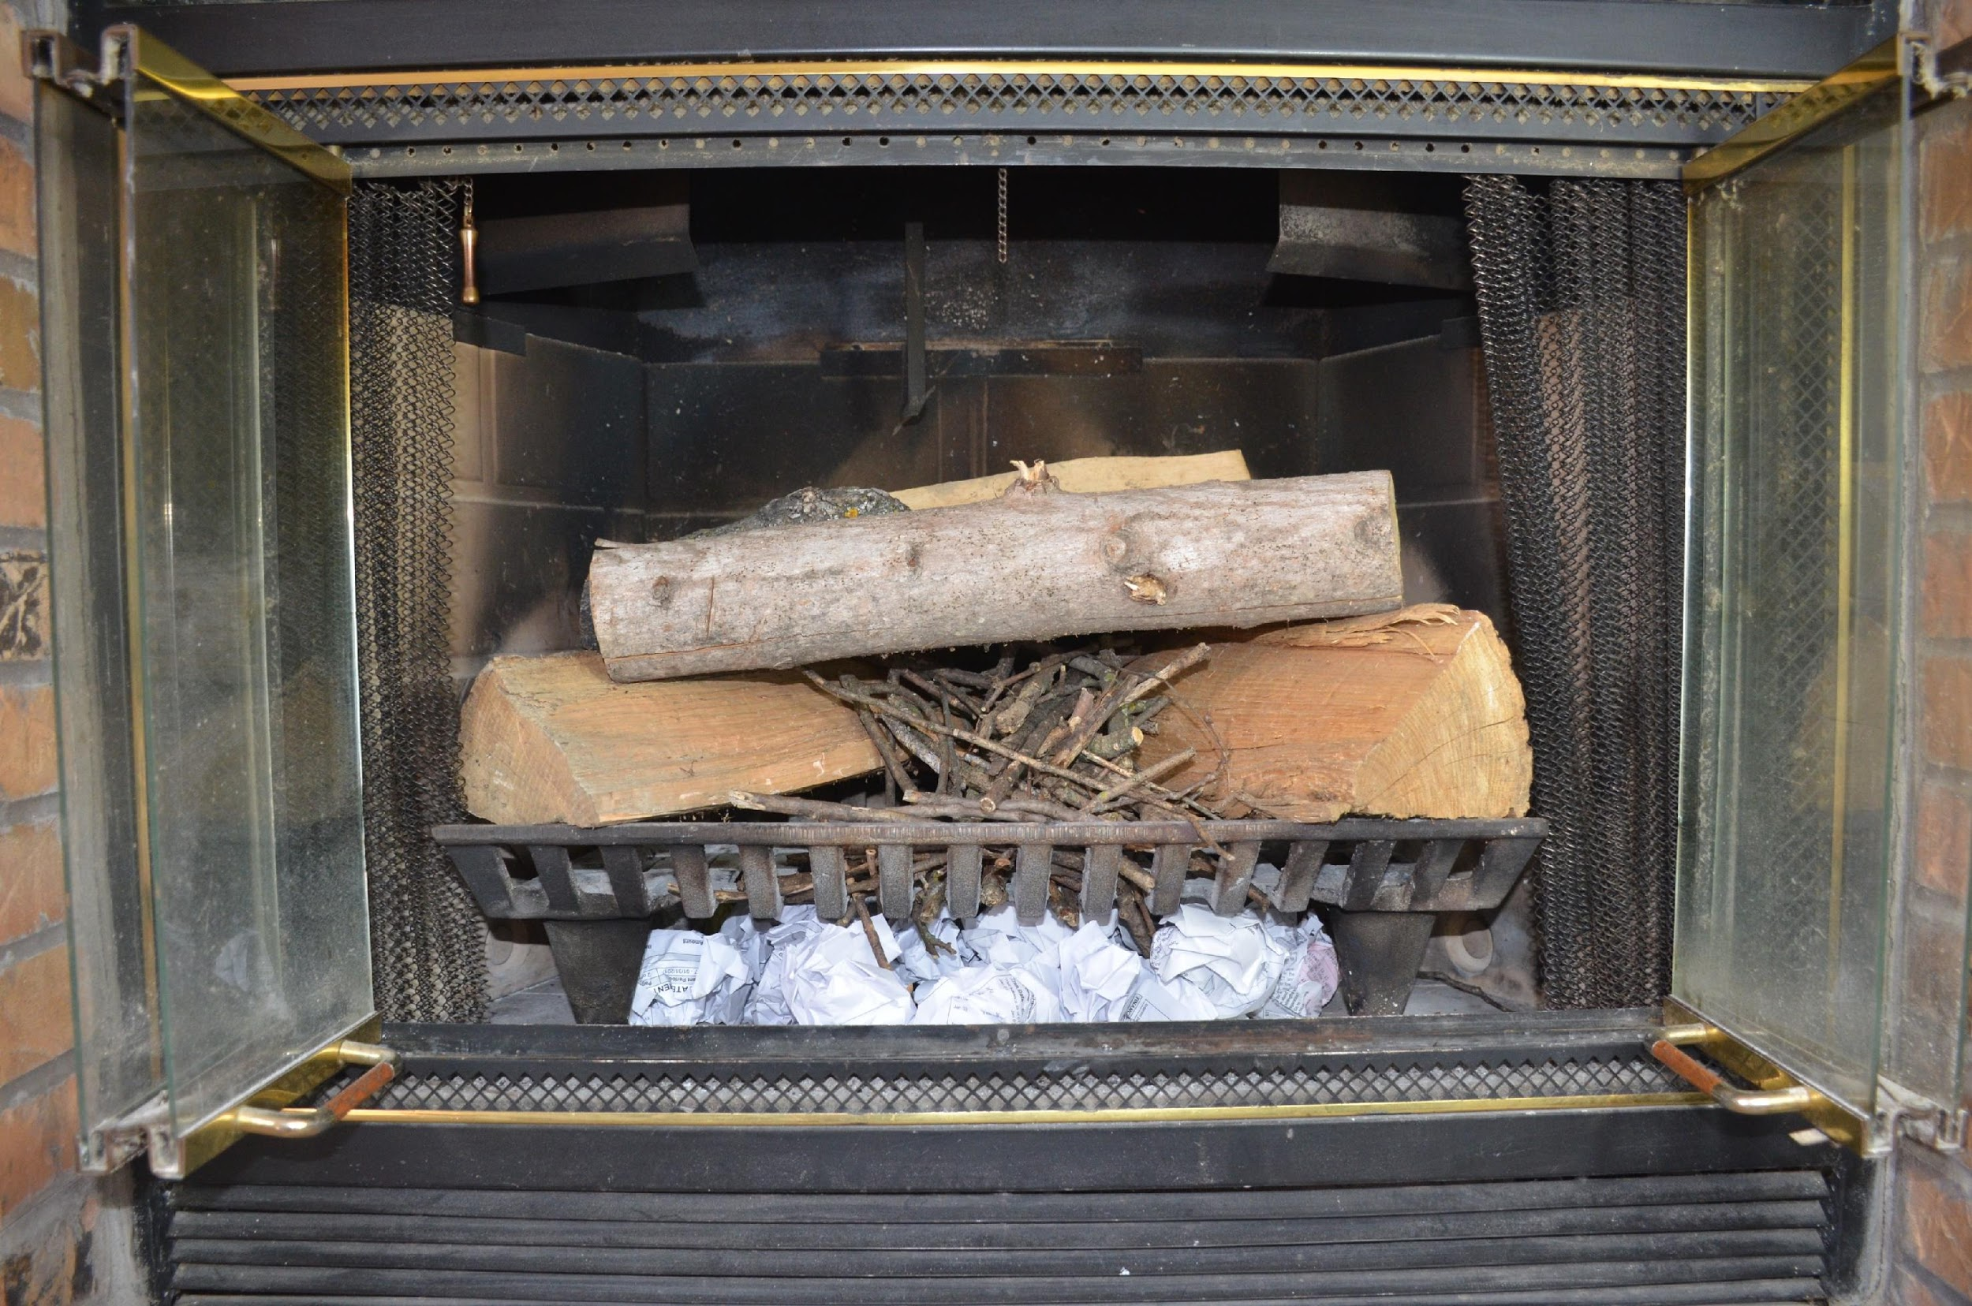
Here are the steps for how to stack wood for a fire that will produce maximum heat to warm your room.
Place two logs in a “V” shape on the fire grate with the “open” end of the “V” shape facing the room.
Place kindling in the middle of the “V”.
Place three smaller pieces of wood across the top of the “V”
When the fire has ignited, continue to add wood to the fire in the “V” formation.
The heat will push out toward the room from the center of the “V” causing the room to warm quickly.
BACK
NEXT

Slide 3
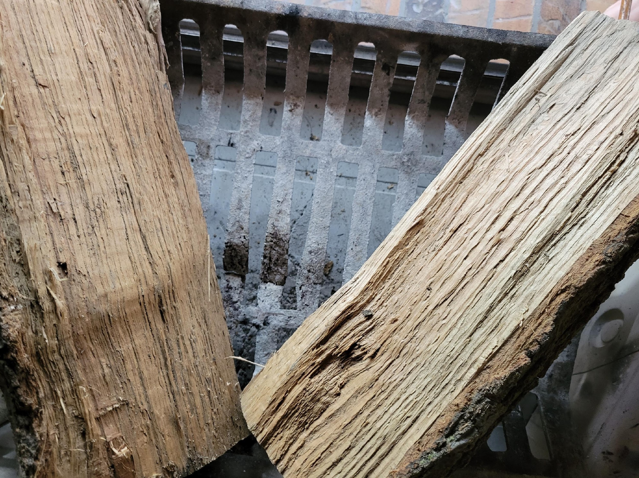
Here are the steps for how to stack wood for a fire that will produce maximum heat to warm your room.
Place two logs in a “V” shape on the fire grate with the “open” end of the “V” shape facing the room.
Front View
Top-Down View
BACK
NEXT

Slide 4
NEXT
Here are the steps for how to stack wood for a fire that will produce maximum heat to warm your room.
Place kindling in the middle of the “V” and under the grate.
Front View
BACK
NEXT

Slide 5
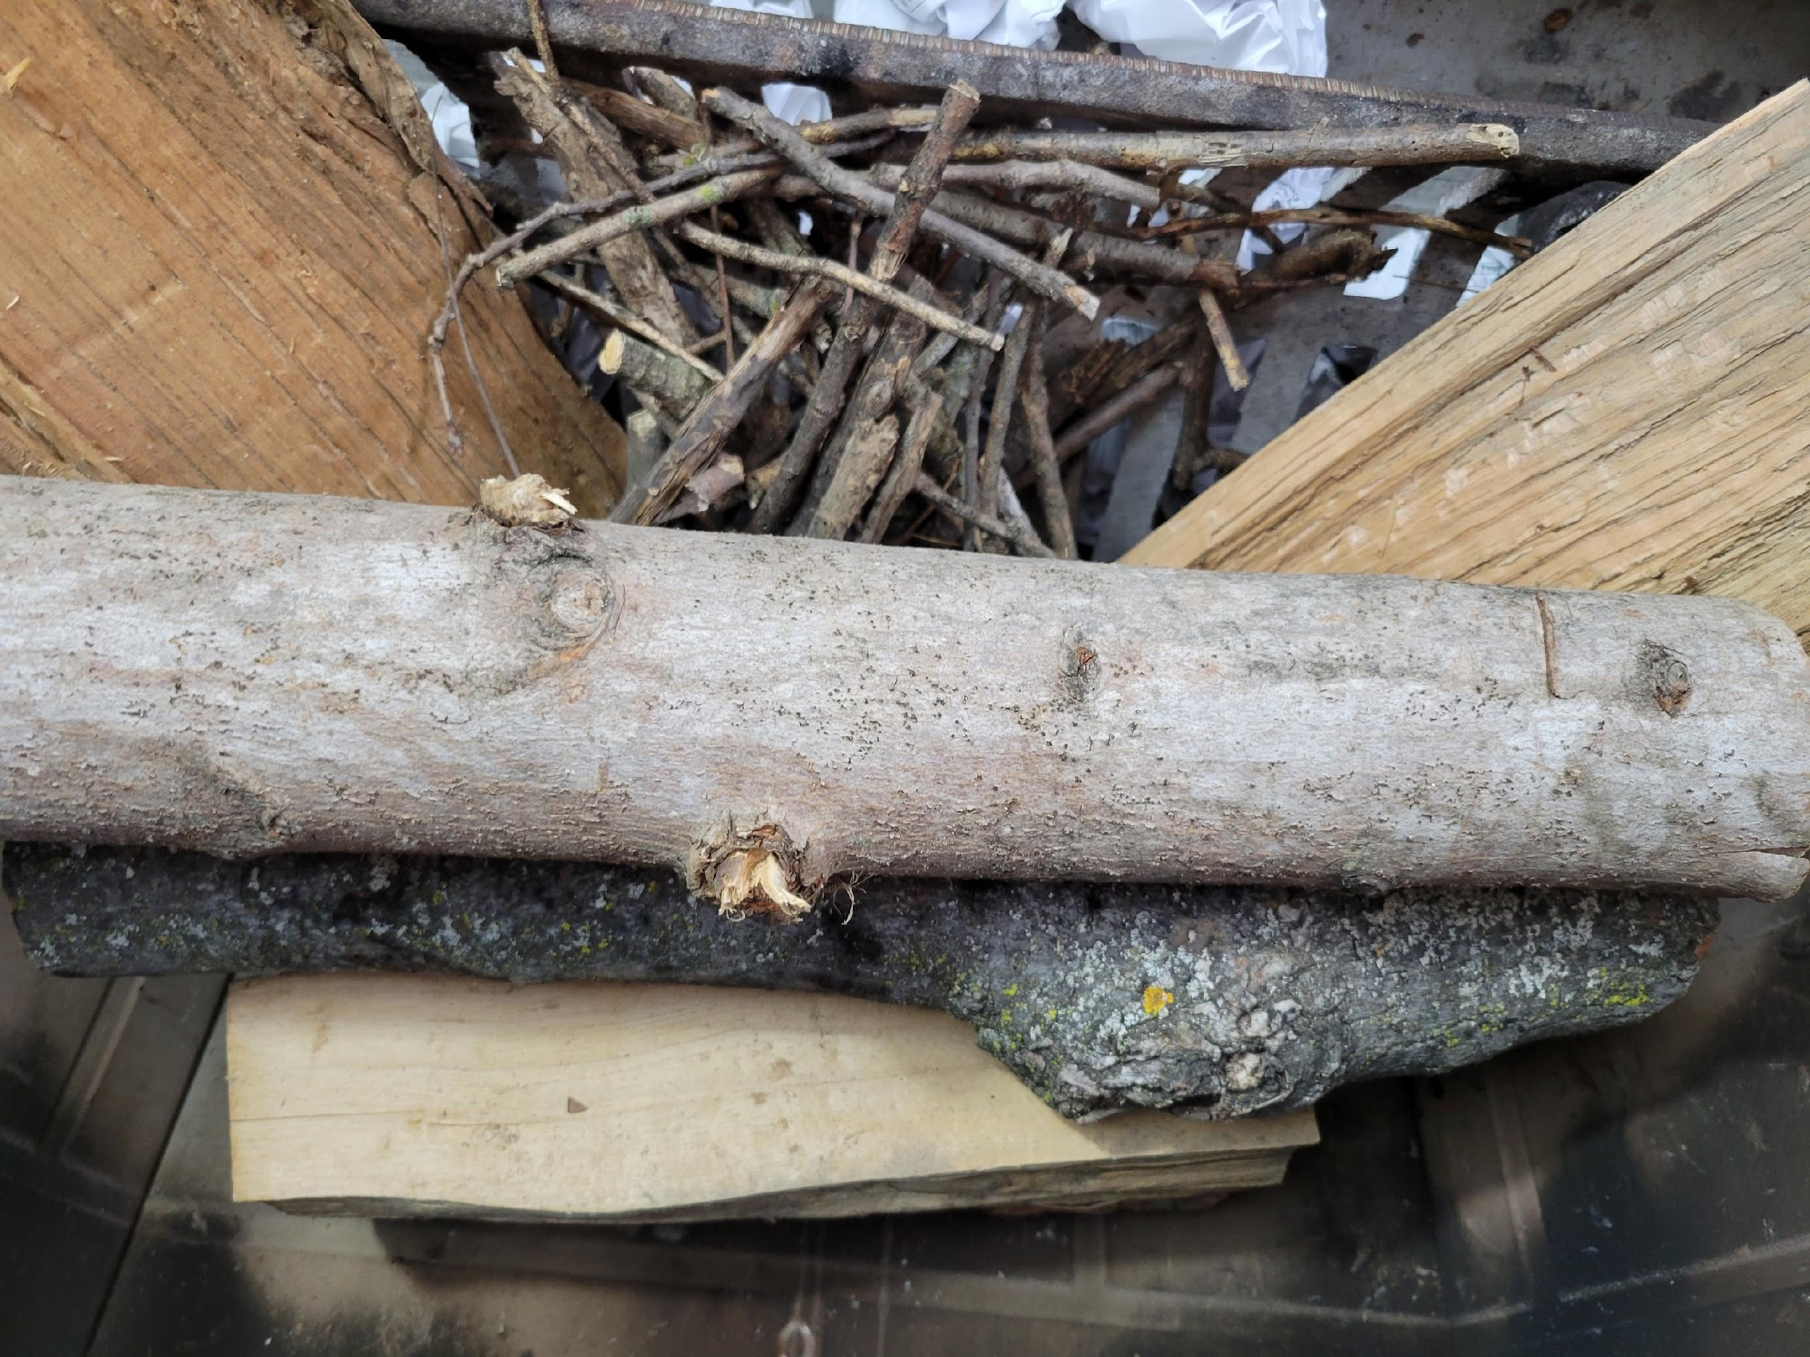
Here are the steps for how to stack wood for a fire that will produce maximum heat to warm your room.
Place three smaller piece of wood across the top of the “V”
Front View
Top-Down View
BACK
NEXT

Slide 6
Here are the steps for how to stack wood for a fire that will produce maximum heat to warm your room.
Using the photos and a separate sheet of paper, write the steps for stacking wood for a fire that will burn for a long period of time.
Hint:
The heat will push out toward the room from the center of the “V” causing the room to warm quickly.
Click Here For
Comparison
BACK
NEXT

Slide 7
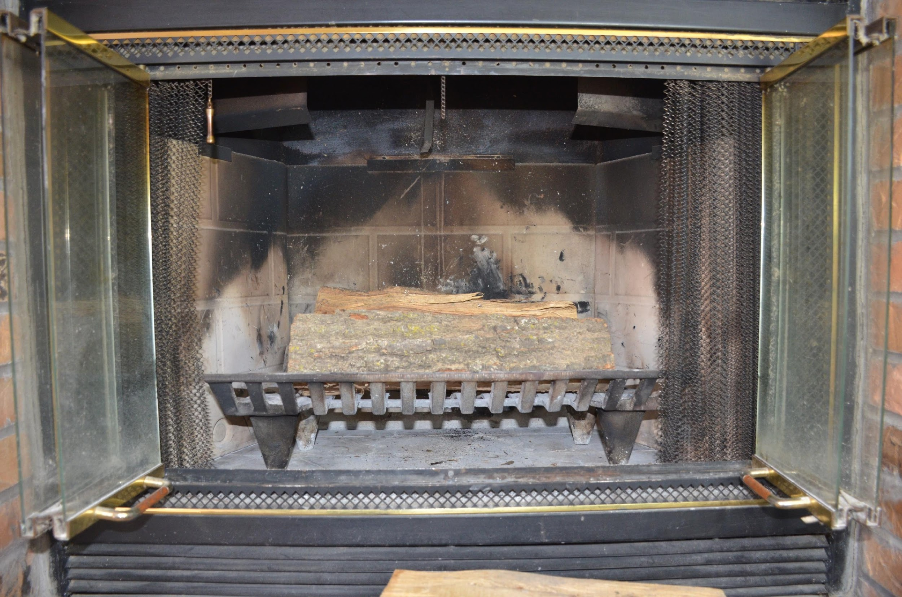
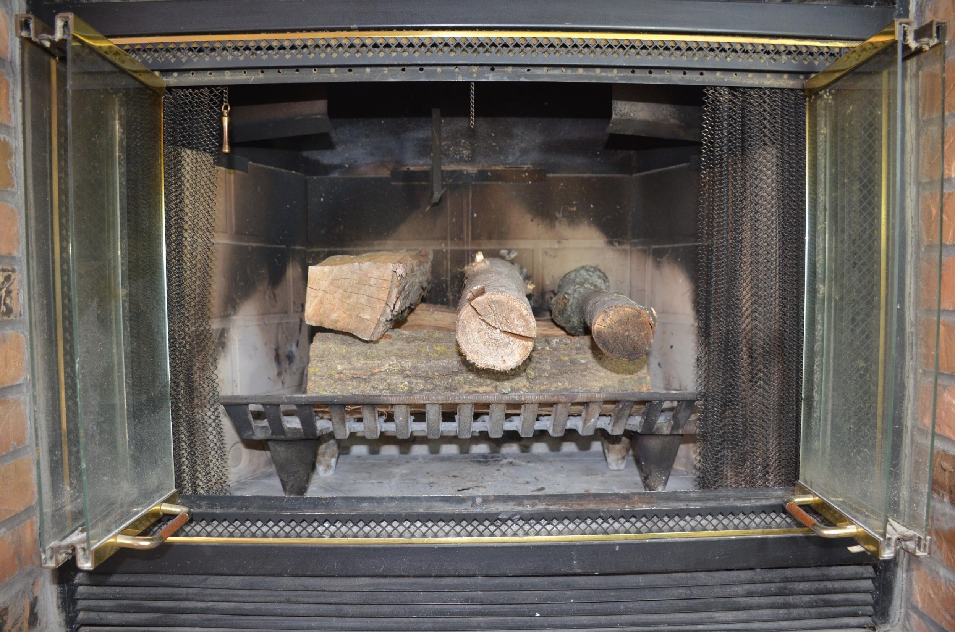
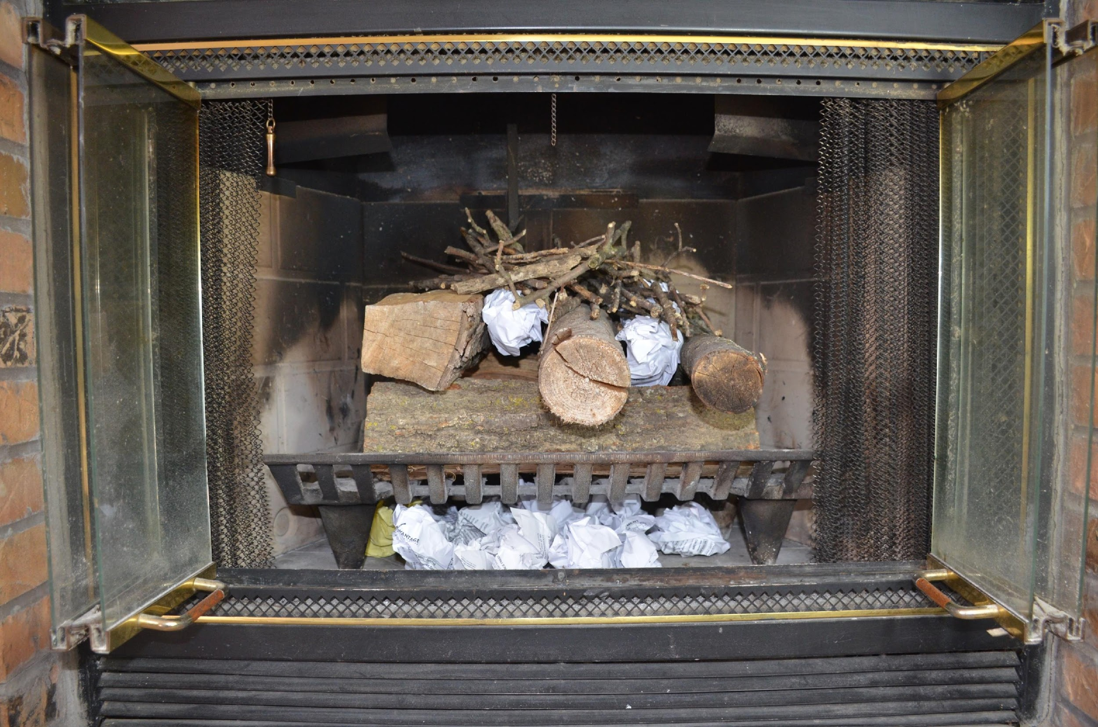
Here are the steps for how to stack wood for a fire that will burn for a long period of time.
Place two large pieces of wood parallel across the fire grate about two inches apart.
Place three smaller pieces of wood perpendicular across the top of the two larger cut logs.
Place kindling on top of the smaller pieces of wood and under the fire grate.
When fire has ignited, continue to add wood to the fire alternating parallel formation.
The fire will burn from the top down causing the fire to burn longer.
BACK
NEXT

Slide 8
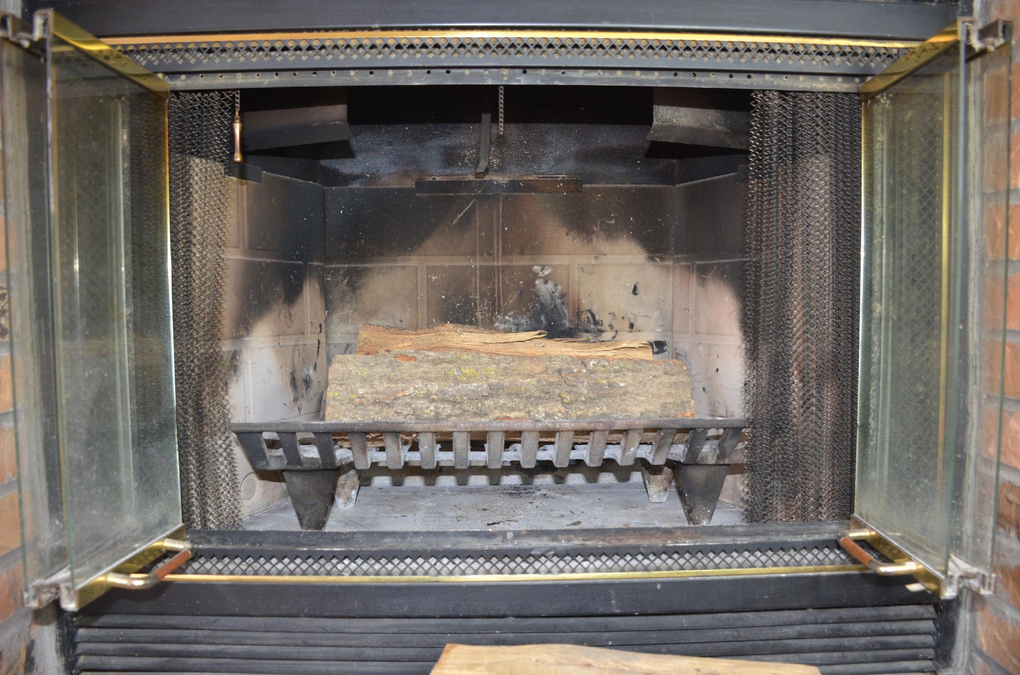
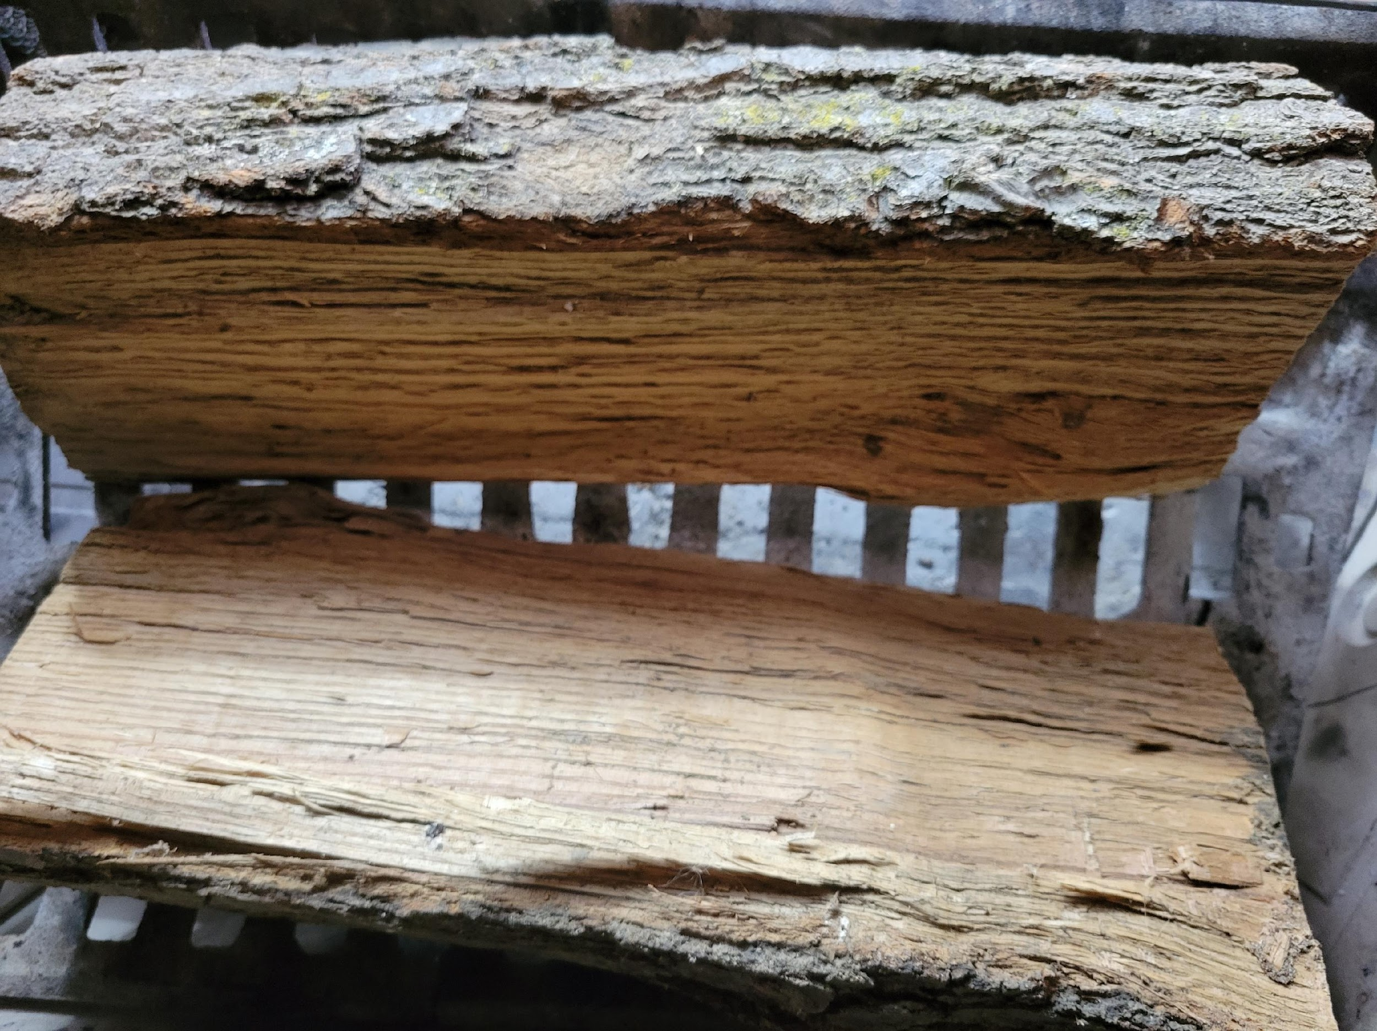
Here are the steps for how to stack wood for a fire that will burn for a long period of time.
Place two large pieces of wood parallel across the fire grate about two inches apart.
Front View
Top-Down View
BACK
NEXT

Slide 9
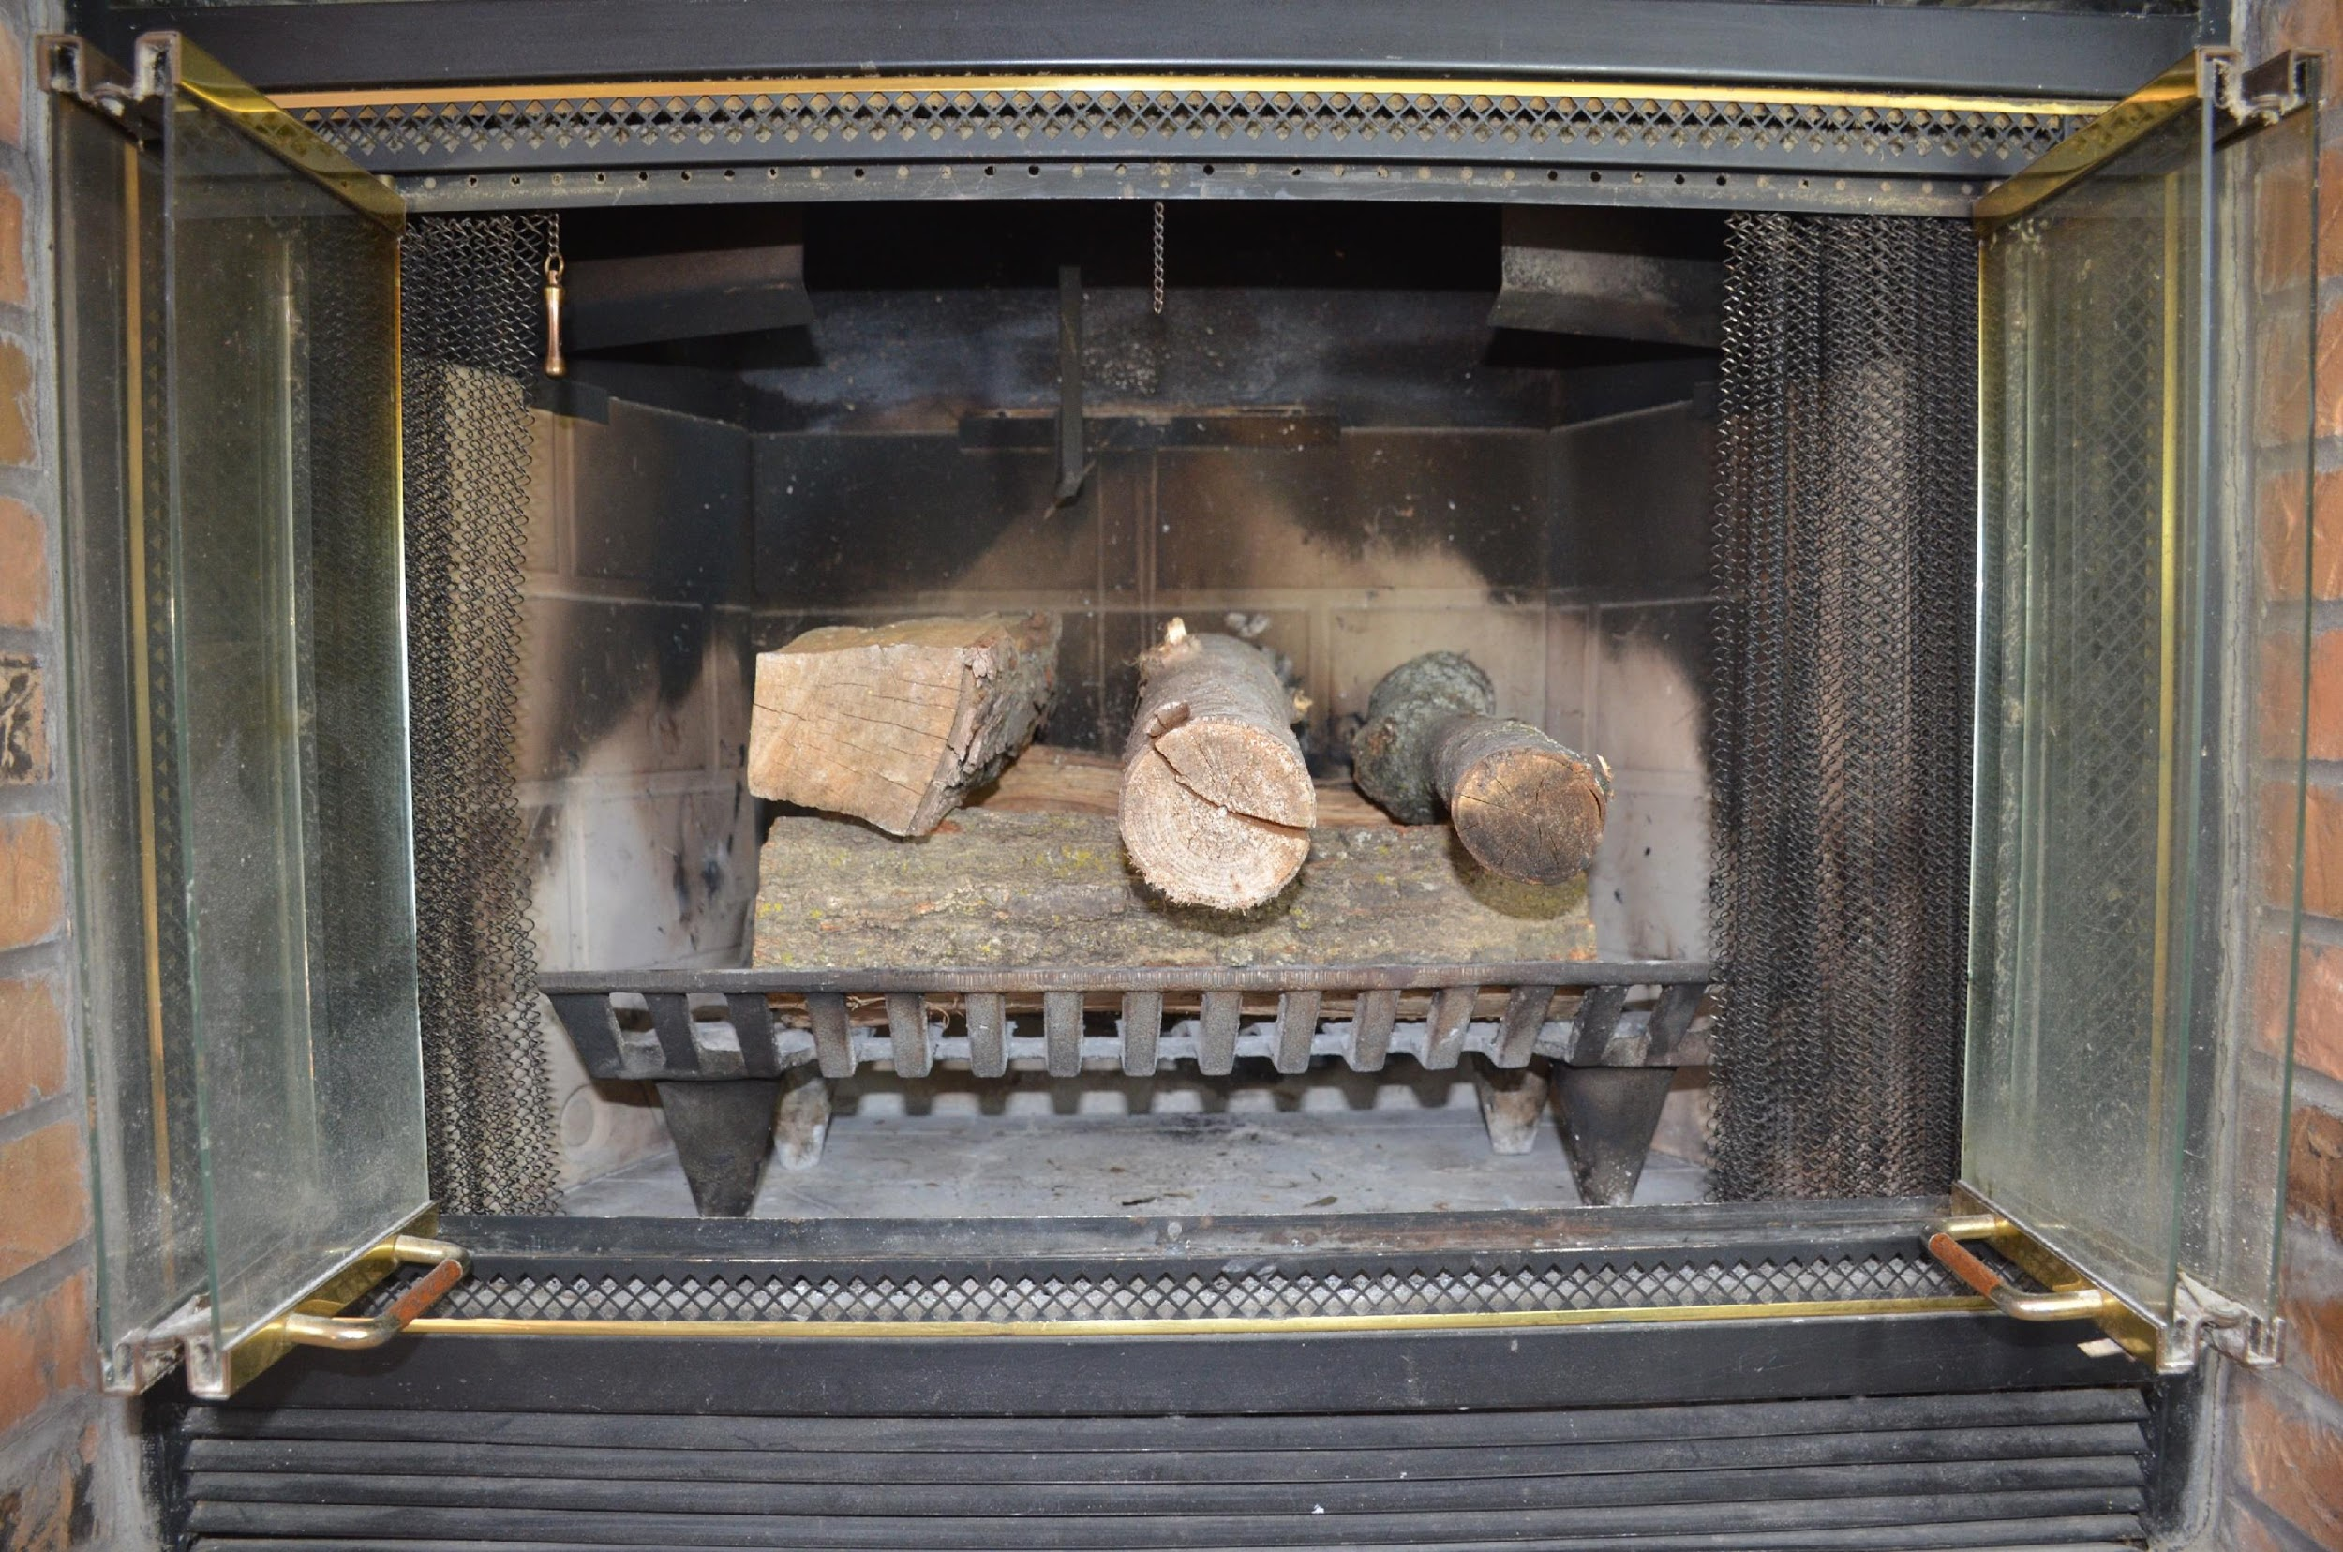
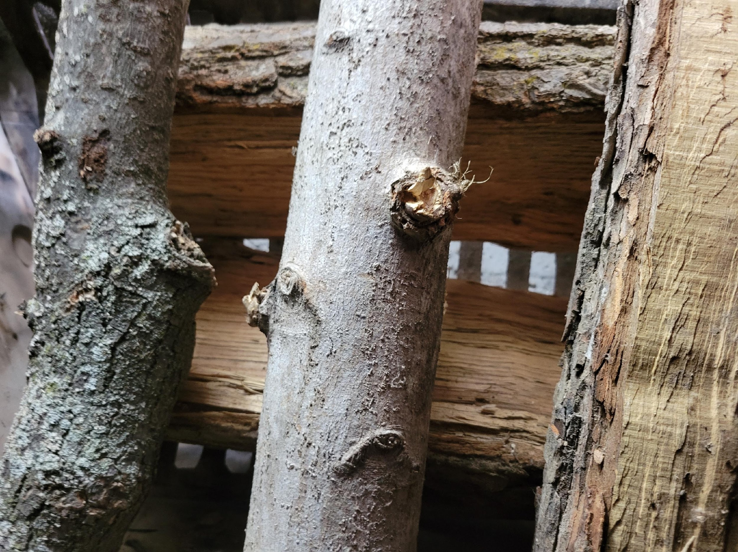
Here are the steps for how to stack wood for a fire that will burn for a long period of time.
Place three smaller pieces of wood perpendicular across the top of the two larger cut logs.
Front View
Top-Down View
BACK
NEXT

Slide 10

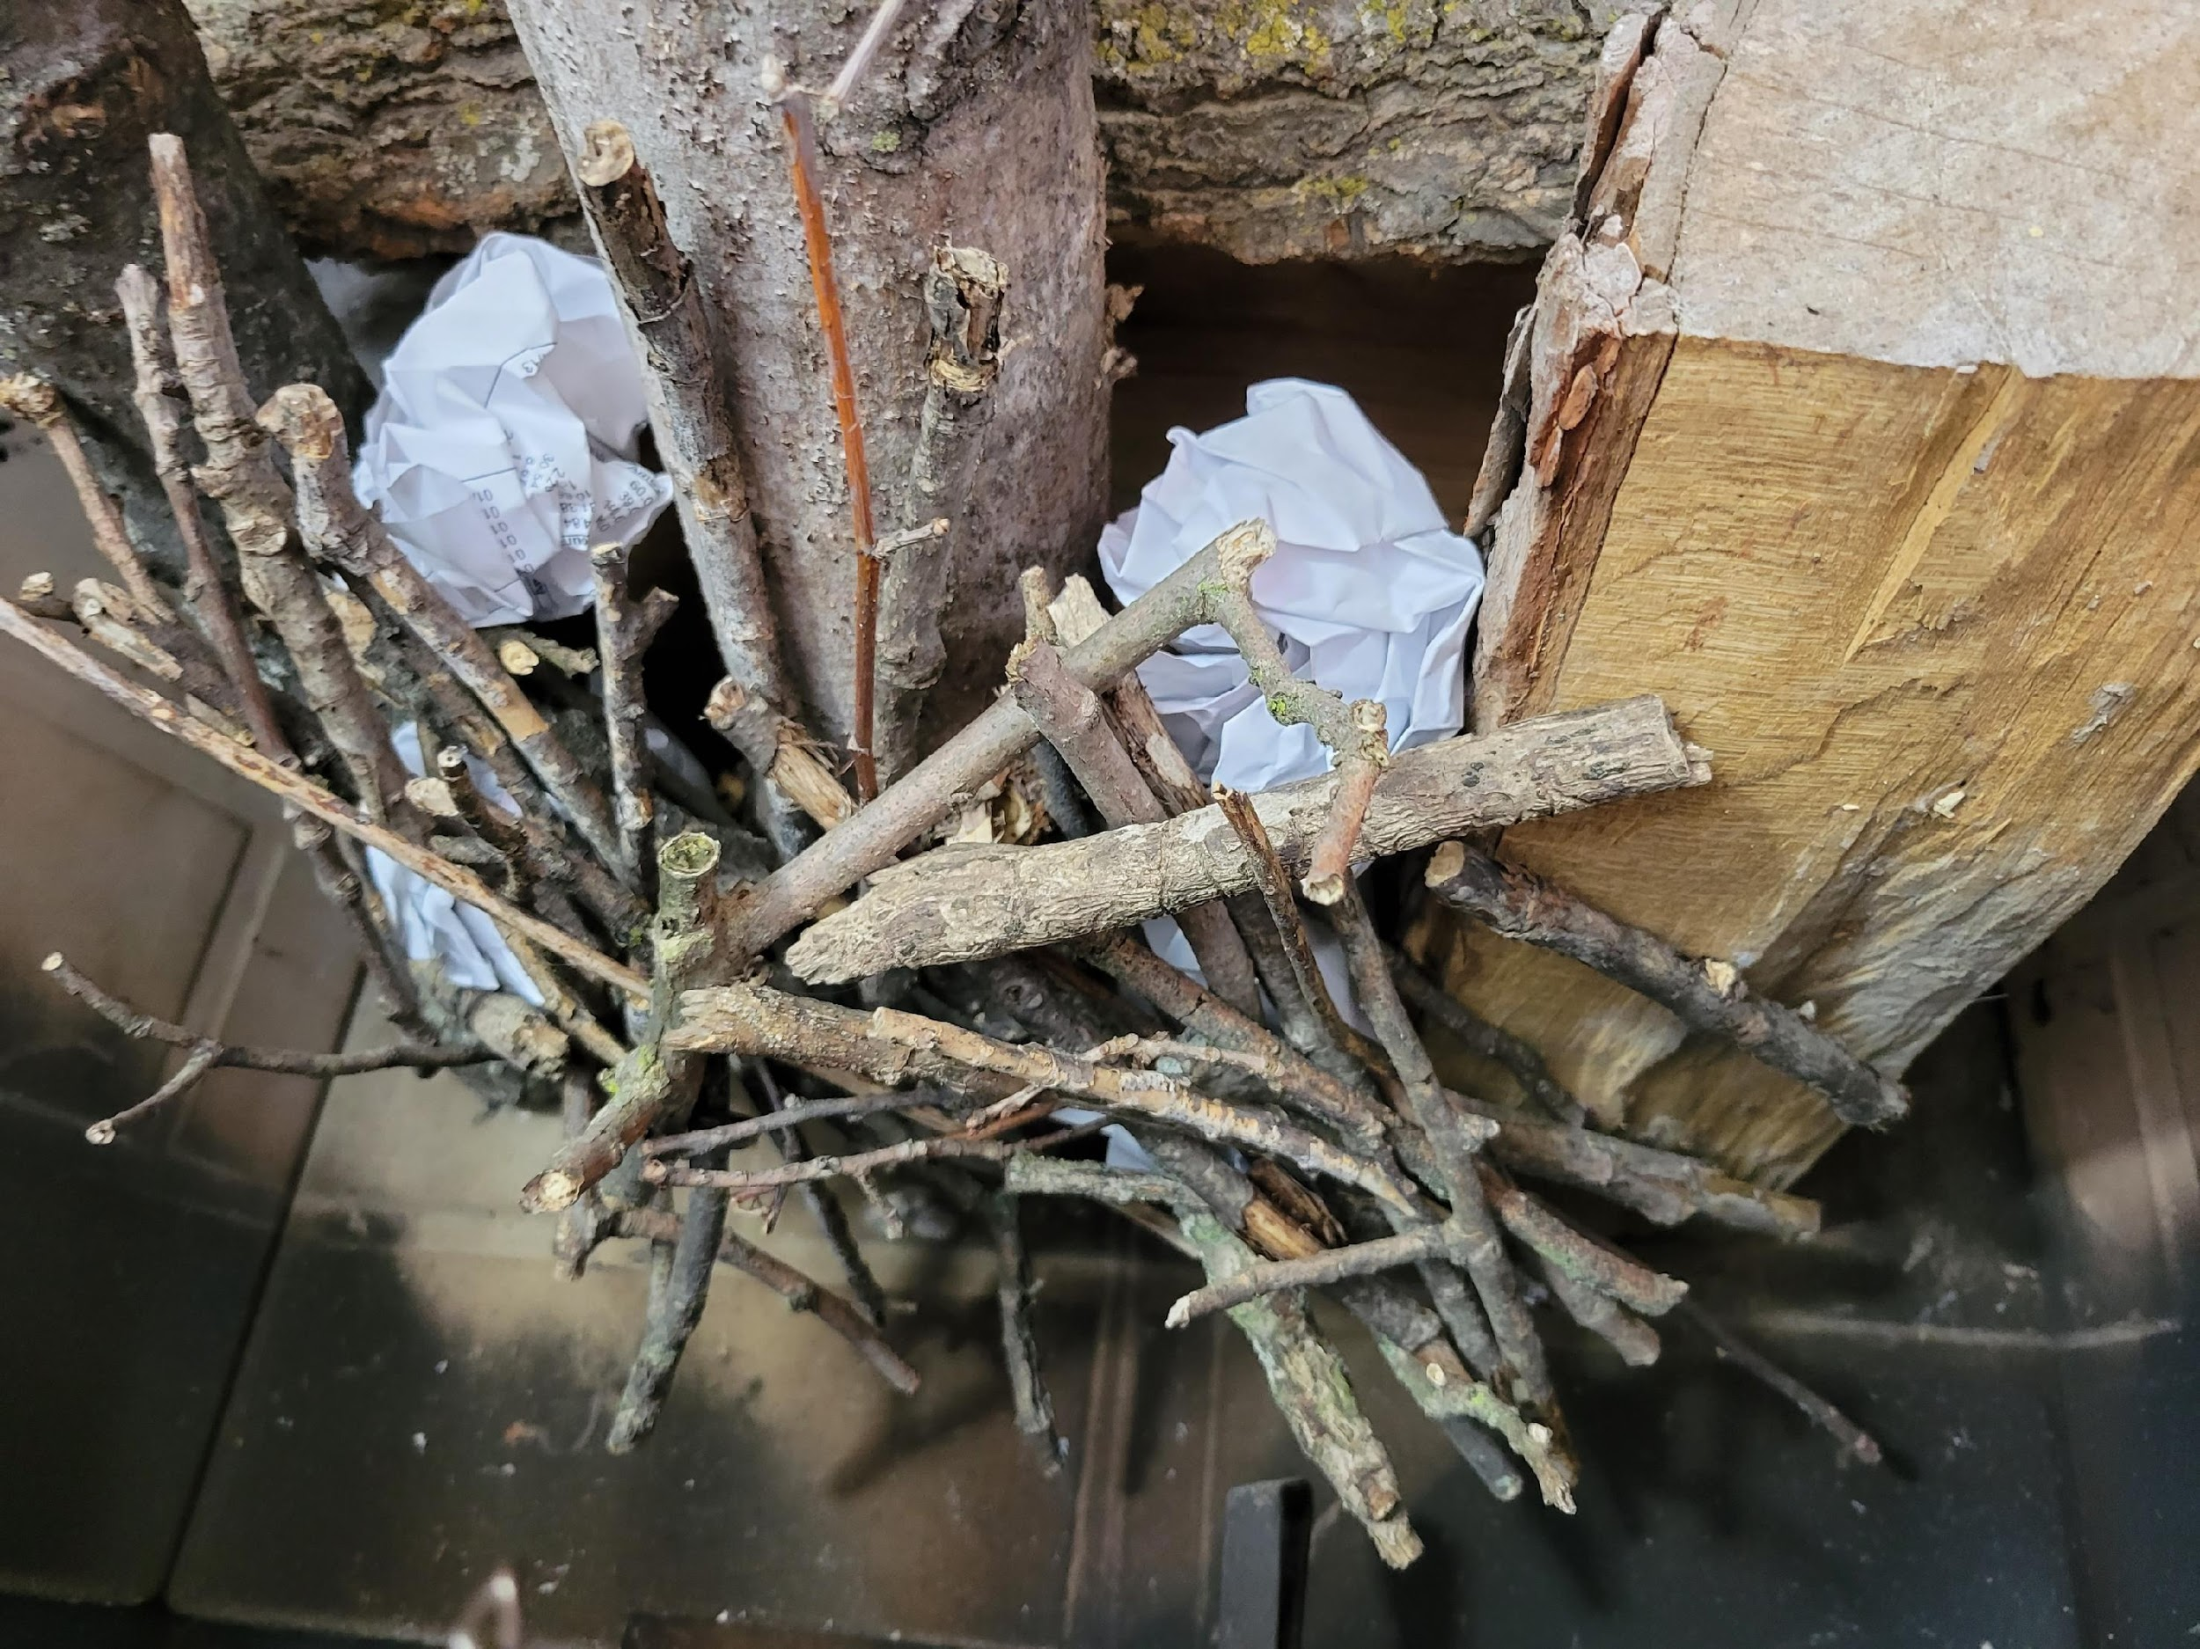
Here are the steps for how to stack wood for a fire that will burn for a long period of time.
Place kindling on top of the smaller pieces of wood and under the fire grate.
Front View
Top-Down View
BACK
NEXT

Slide 11
Here are the steps for how to stack wood for a fire that will burn for a long period of time.
Using the photos and a separate sheet of paper, write the steps for stacking wood for a fire that will burn for a long period of time.
Hint:
The fire will burn from the top down causing the fire to burn longer.
Click Here For
Comparison
BACK
NEXT

Slide 12
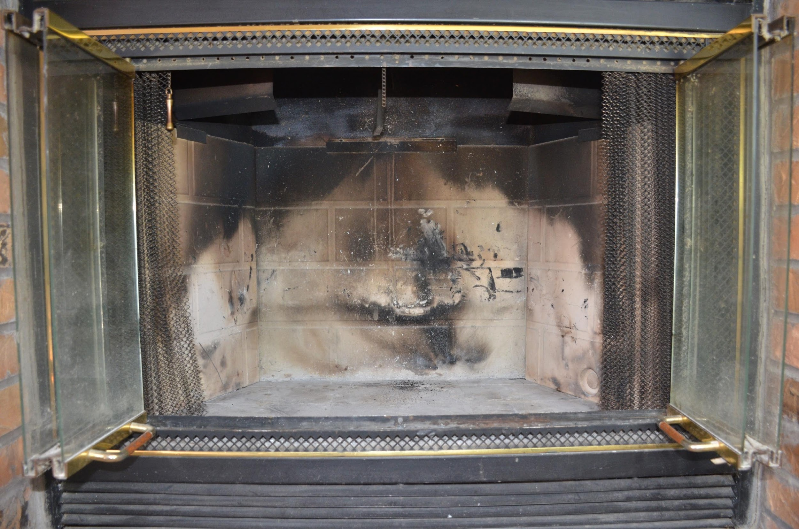
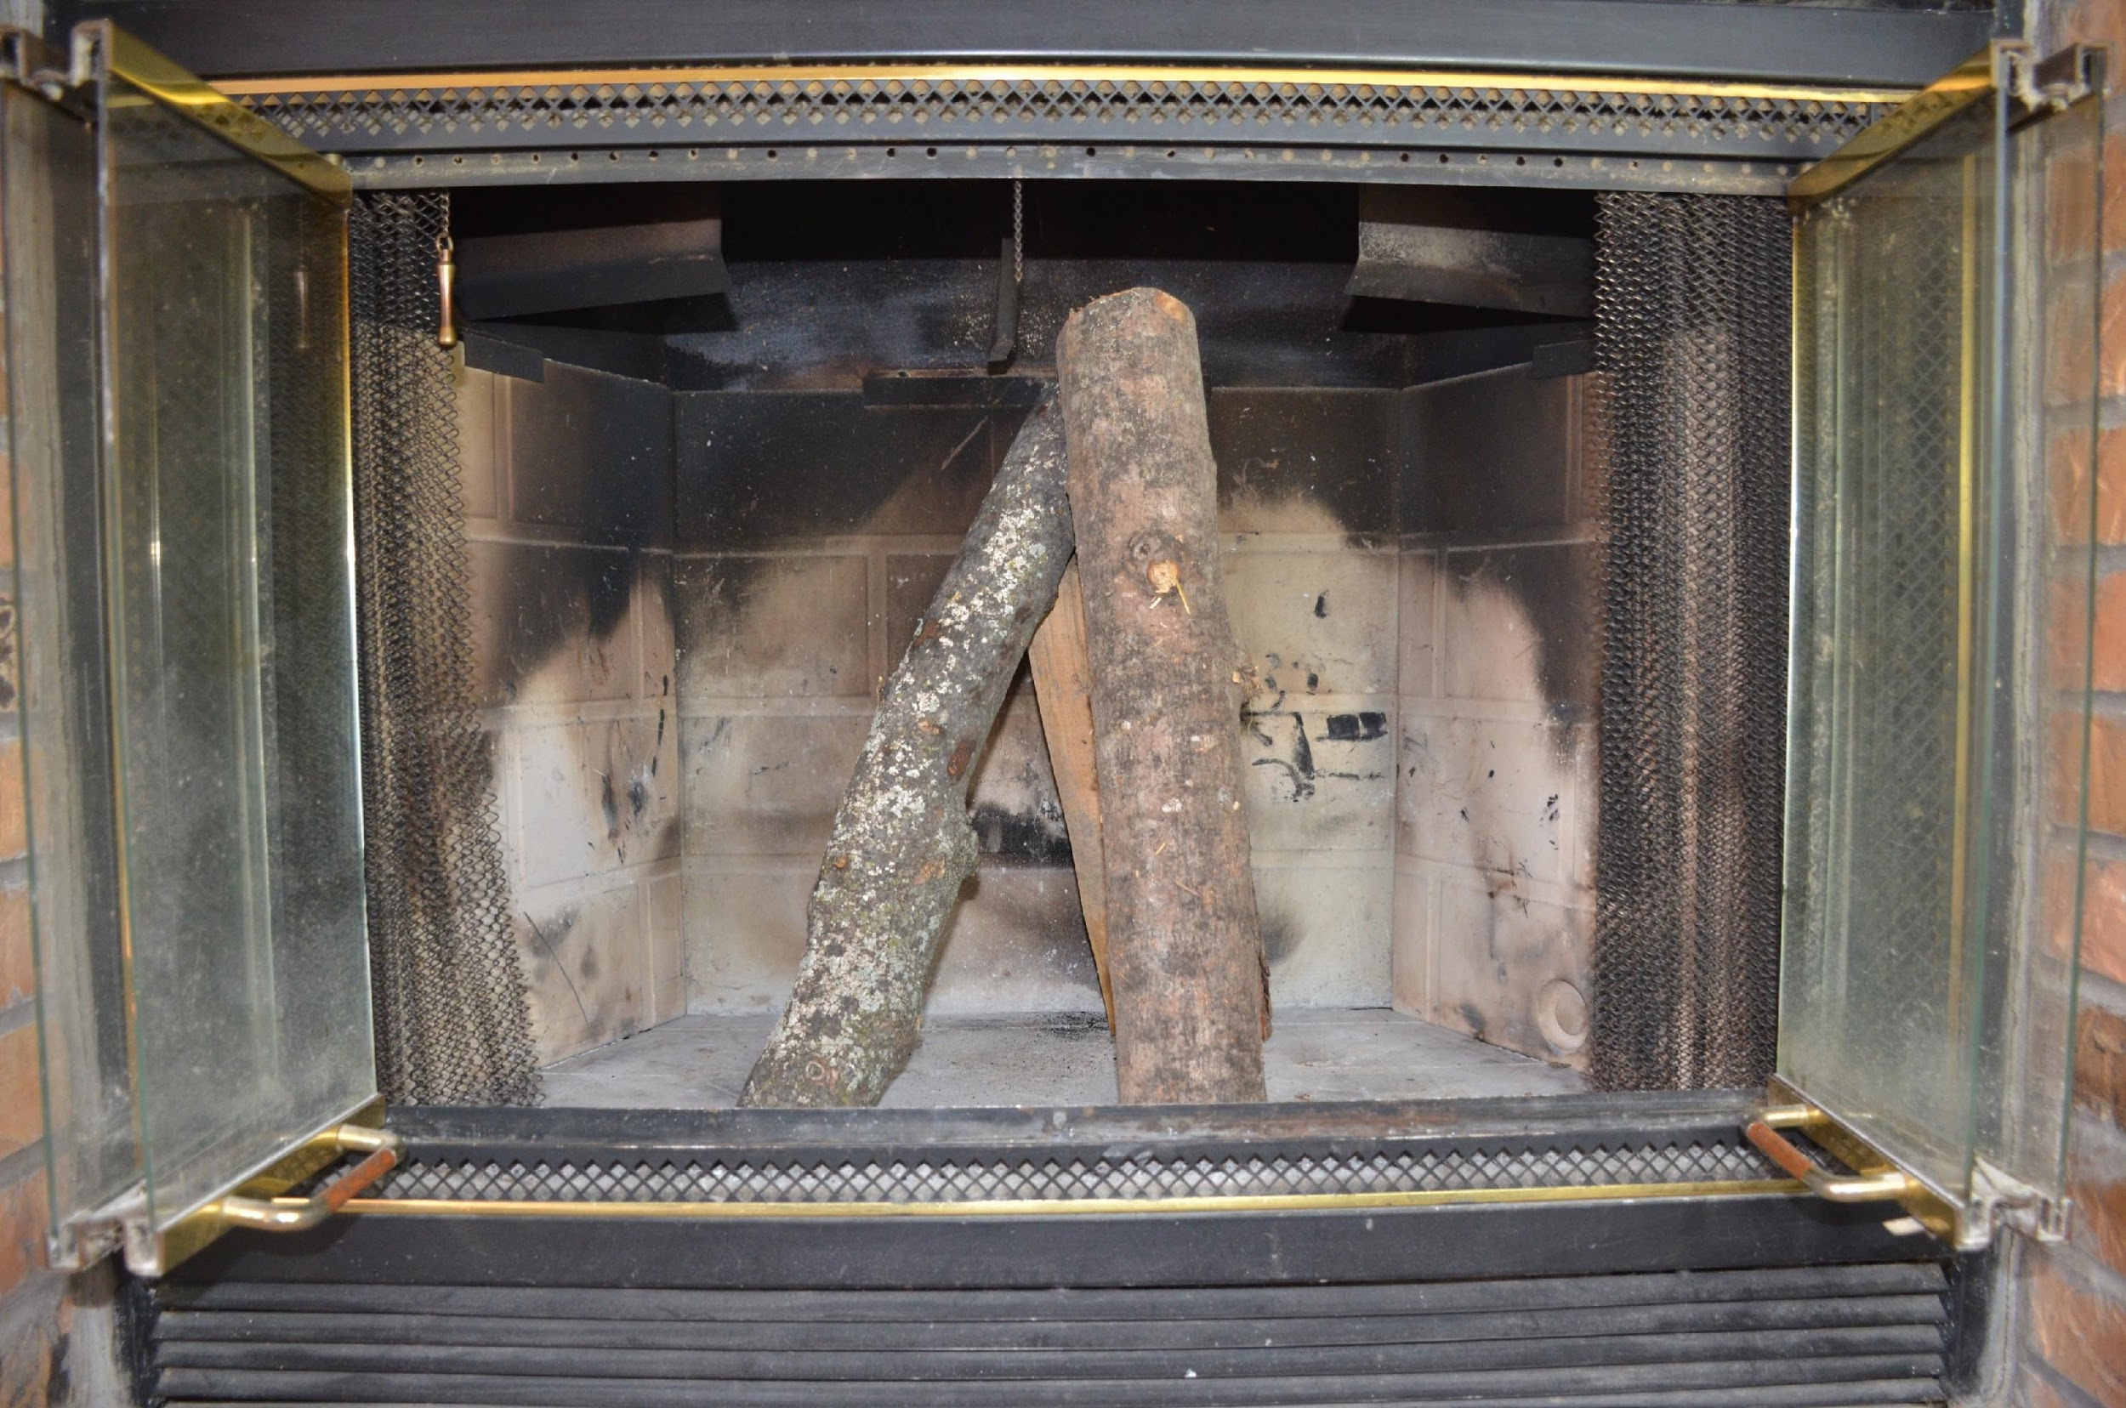
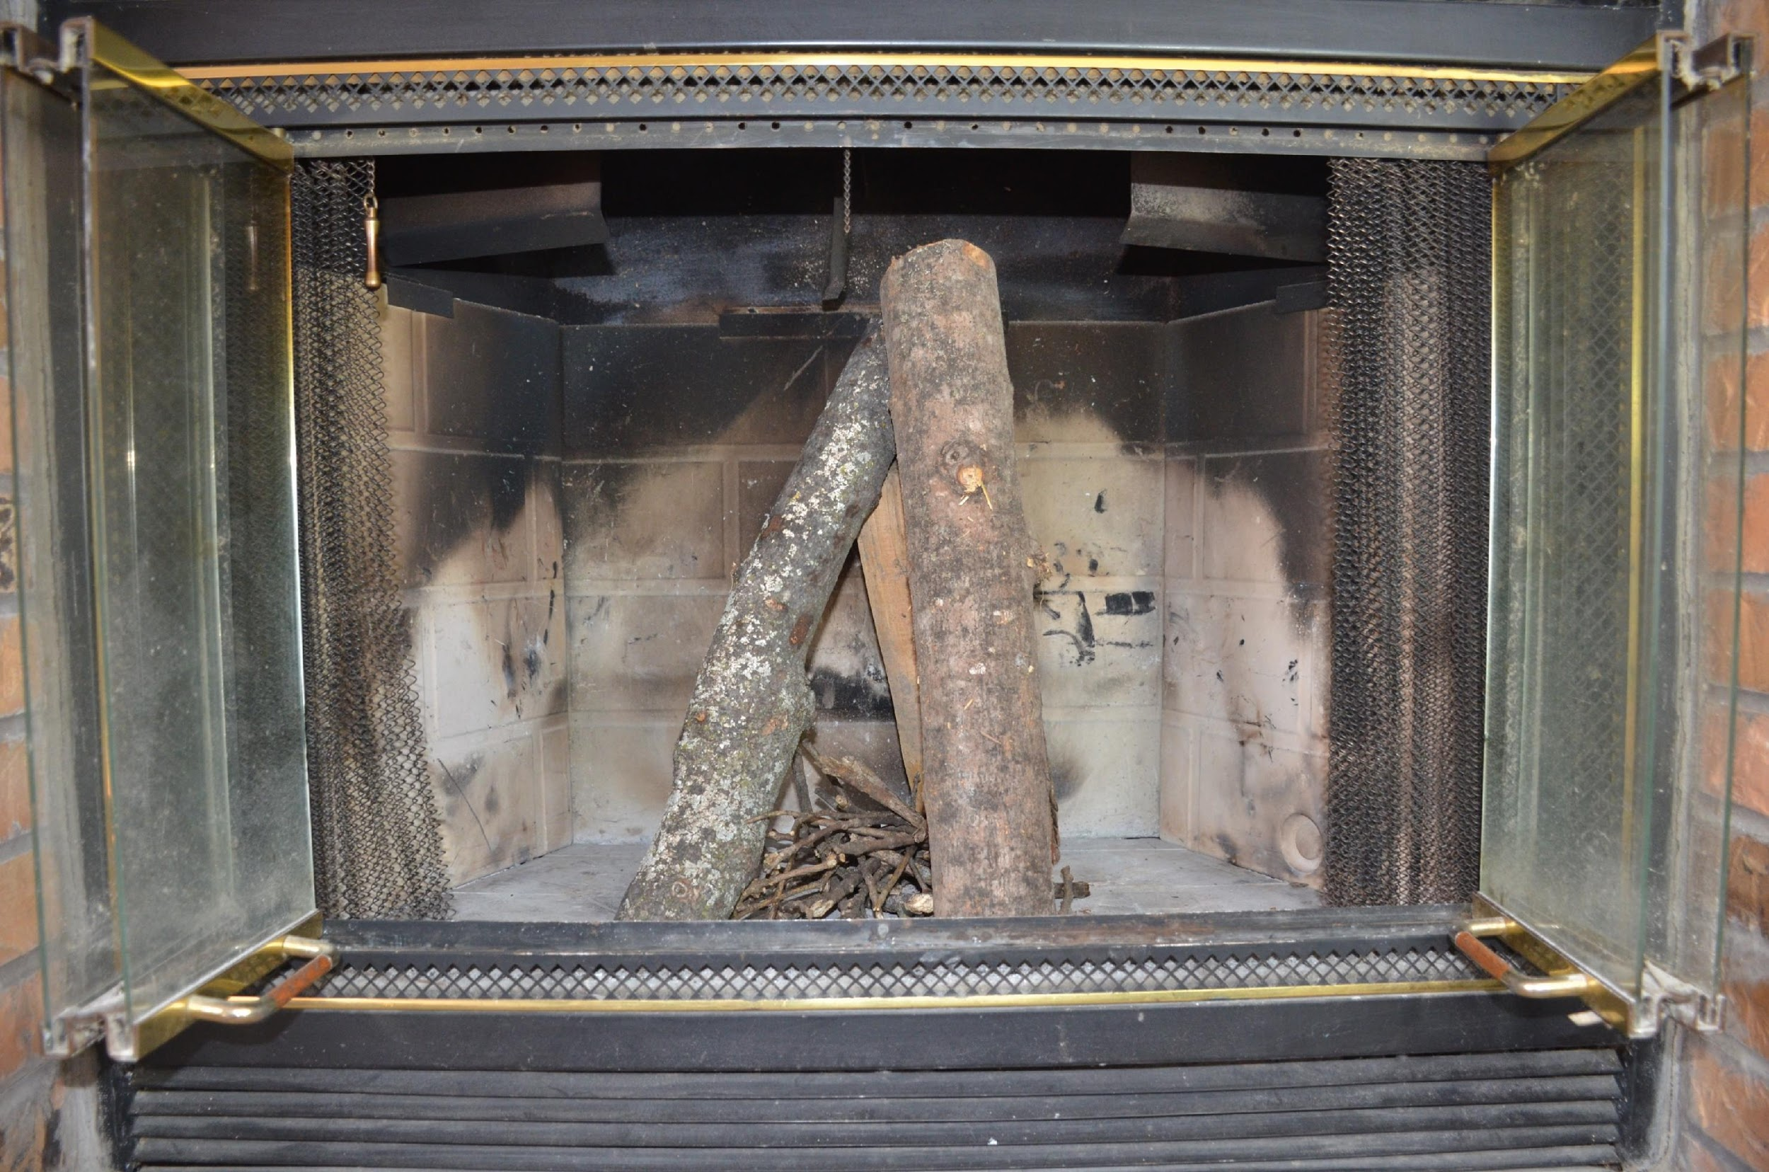
Here are the steps for how to stack wood for a fire that will give a colorful ambiance
Remove the fire grate from the fireplace.
Place three midsized pieces of wood in a tepee formation in the fireplace.
Place kindling in the tepee formation.
When fire has ignited, continue to add wood to the fire in the tepee formation.
The fire will burn from the middle to the top causing hot flames, cools flames, and several hues of umber.
BACK
NEXT

Slide 13
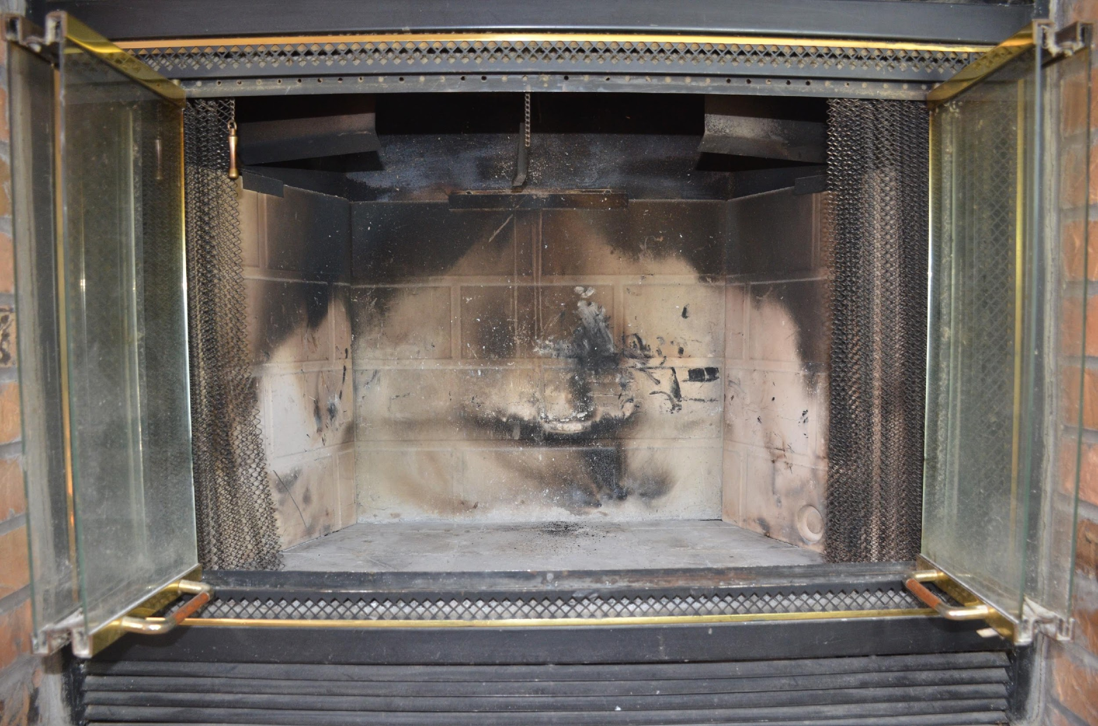
NEXT
Here are the steps for how to stack wood for a fire that will give a colorful ambiance
Remove the fire grate from the fireplace.
Front View
BACK
NEXT

Slide 14

NEXT
Here are the steps for how to stack wood for a fire that will give a colorful ambiance
Place three midsized pieces of wood in a tepee formation in the fireplace.
Front View
BACK
NEXT

Slide 15

NEXT
Here are the steps for how to stack wood for a fire that will give a colorful ambiance
Place kindling in the tepee formation.
Front View
BACK
NEXT

Slide 16
Here are the steps for how to stack wood for a fire that will give a colorful ambiance
Using the photos and a separate sheet of paper, write the steps for stacking wood for a fire that will give a colorful ambiance
Hint:
The fire will burn from the middle to the top causing hot flames, cools flames, and several hues of umber.
Click Here For
Comparison
BACK
NEXT

Slide 17
This is the end of the instruction.
You should now be able to describe how to:
stack wood for a fire in a fireplace that will produce maximum heat to warm your room.
Stack wood for a fire in a fireplace that will burn for the longest period of time.
Stack wood for a desired ambiance.
If you are unable to describe the steps for each of these process, you might want to go back and review the presentation again, make notes and write in your own words the steps for each process.
Press Escape
To end Presentation
RETURN TO
THE BEGINNING

Slide 18
You should have written something similar to the steps below for how to stack wood for a fire that will produce maximum heat to warm your room.
Place two logs in a “V” shape on the fire grate with the “open” end of the “V” shape facing the room.
Place kindling in the middle of the “V”.
Place three smaller piece of wood across the top of the “V”
When fire has ignited, continue to add wood to the fire in the “V” formation.
If you are unable to describe the steps for the process, you might want to go back and review the steps again, make notes and write in your own words the steps for the process.
Back to Instruction
Continue Instruction

Slide 19
You should have written something similar to the below steps for how to stack wood for a fire that will burn for a long period of time.
Place two large pieces of wood parallel across the fire grate about two inches apart.
Place three smaller pieces of wood perpendicular across the top of the two larger cut logs.
Place kindling on top of the smaller pieces of wood and under the fire grate.
When fire has ignited, continue to add wood to the fire alternating parallel formation.
If you are unable to describe the steps for the process, you might want to go back and review the steps again, make notes and write in your own words the steps for the process.
Continue Instruction
Back to Instruction

Slide 20
You should have written something similar to the below steps for how to stack wood for a fire that will give a colorful ambiance
Remove the fire grate from the fireplace.
Place three midsized pieces of wood in a tepee formation in the fireplace.
Place kindling in the tepee formation.
When fire has ignited, continue to add wood to the fire in the tepee formation.
The fire will burn from the middle to the top causing hot flames, cools flames, and several hues of umber.
Back to Instruction
Continue Instruction

